Slide 1
VARIABLE AND CONSTANTS

Slide 2
Variable/Constants
Variable is a name given to a storage location in memory
Constant is an immutable value
A name that is given for any computer memory location is called a variable. The purpose of the variable is to provide some name to a memory location where we store some data. The user will access the data by the variable name and the compiler will access the data by the memory address. So, the variable is a named location in the computer memory where a program can store the data.

Slide 3



Declaring Variables /Constants
To declare a variable we use the variable datatype followed by the variable name, then you can choose to initialize the variable or initialize later.
We can not print/use a uninitialized variable
To declare a constant we have to use the const keyword followed by the datatype then the variable name and with constants we have to initialize them

Slide 4
C# Identifiers Rules
An identifier is the name you assign to a type (class, interface, struct, record, delegate, or enum), member, variable, or namespace.
Valid identifiers must follow these rules:
Identifiers must start with a letter or underscore (_).
Identifiers may contain Unicode letter characters, decimal digit characters, Unicode connecting characters
Identifier cannot be a reserved keyword
You can declare identifiers that match C# keywords by using the @ prefix on the identifier. The @ is not part of the identifier name. For example, @if declares an identifier named if.
Always use meaningful names e.g. instead of data say studentMarks

Slide 5
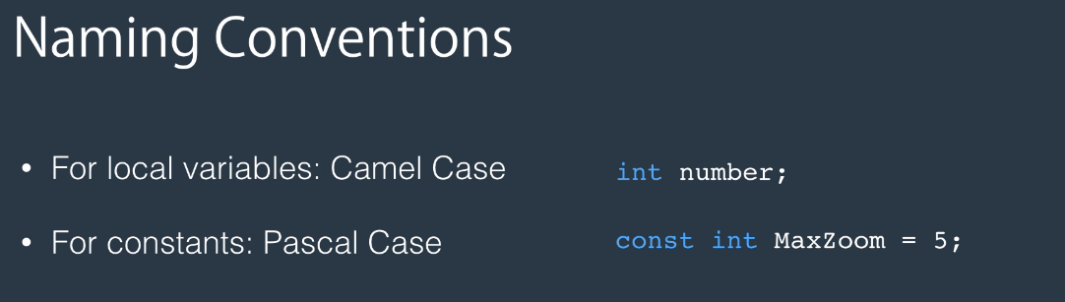

Naming convention
camelCase : firstName
Pascal Case :FirstName
Hungarian Notation : strFirstName

Slide 6
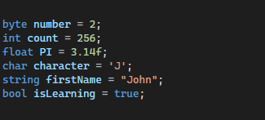
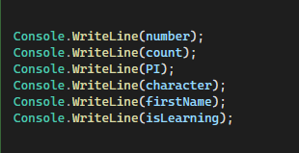
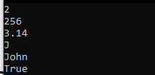
More on variables

Slide 7
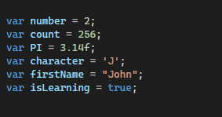
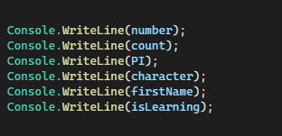
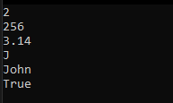
Using The var keyword
var data type was introduced in C# 3.0. var is used to declare implicitly typed local variable means it tells the compiler to figure out the type of the variable at compilation time. A var variable must be initialized at the time of declaration.
For byte however you have to explicitly cast it because the compiler will assign int.

Slide 8
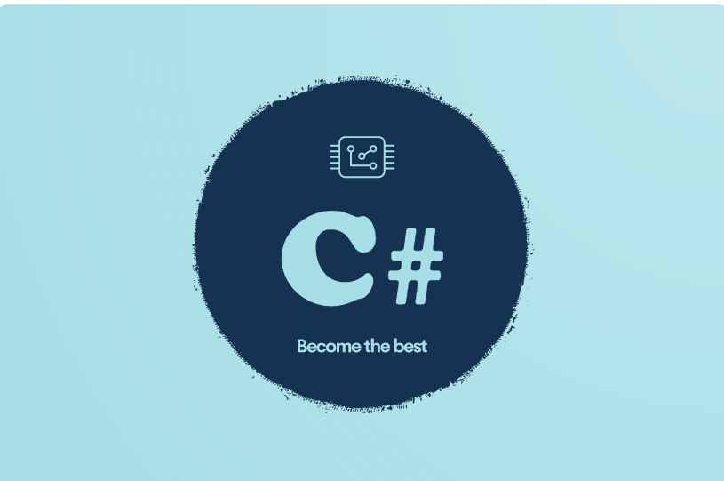
DATATYPES

Slide 9
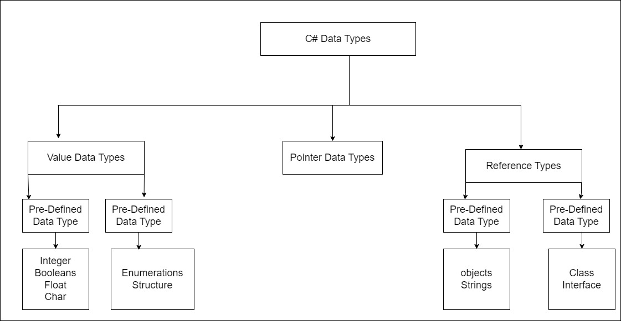

Slide 10
PRIMITIVE TYPES

Slide 11
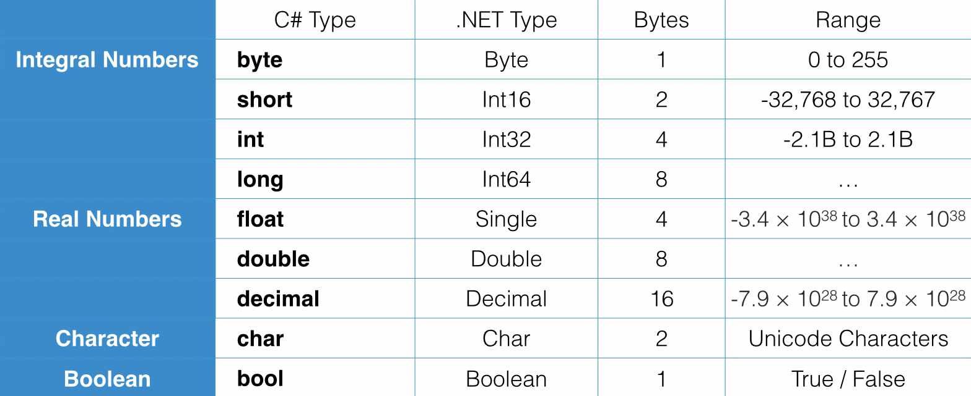

Slide 12
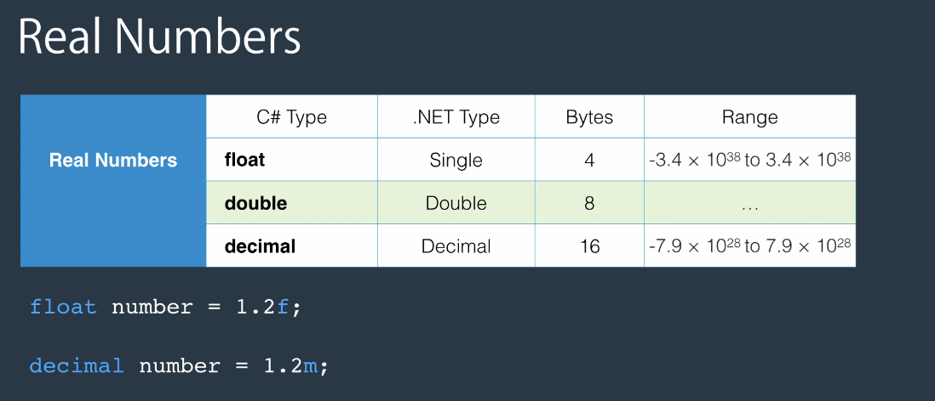

Slide 13
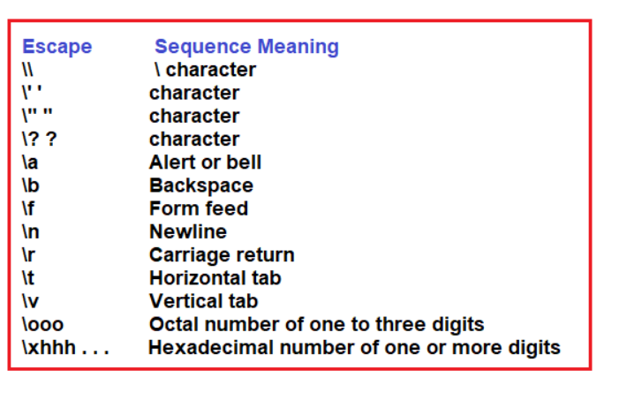
What is a char Datatype
Char is a 2-byte length data type that can contain Unicode data. You can represent Unicode characters as UTF-8 and UTF-16 and so on .

Slide 14
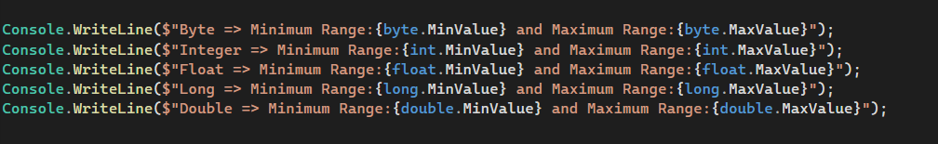
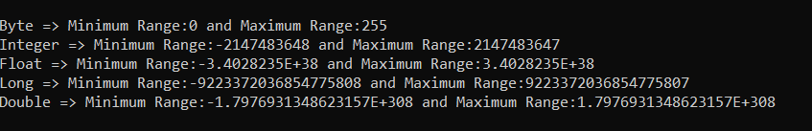
How to Get the Minimum and Maximum Range of Values of Built-in Data Types in C#?

Slide 15
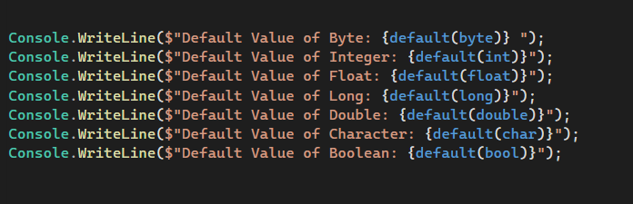
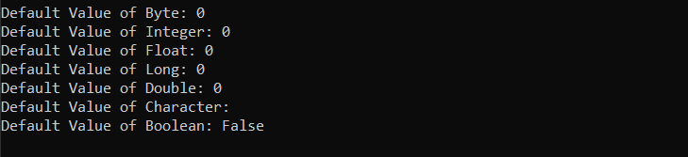
Getting Default Values

Slide 16
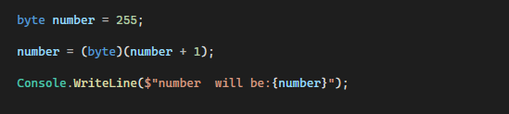

Overflowing

Slide 17
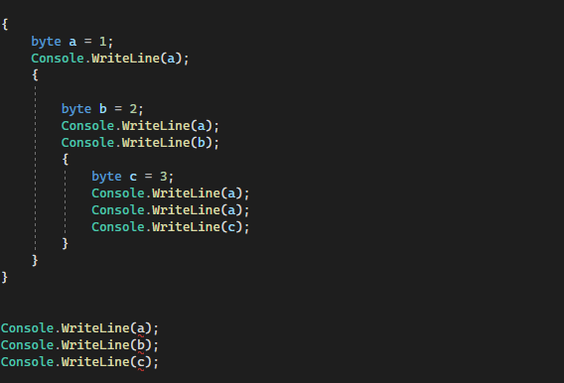
Scope
Scope is where a variable or a constant has a meaning

Slide 18
TYPE CONVERSION

Slide 19
Type Conversion
What is Type Casting
This is the C# process of changing one data type value into another data type. Type conversion is only possible in data types that are compatible with each other . If a datatype is not compatible we get a compile time error.
Types of Type Casting
Implicit type conversion
Explicit type conversion (casting)
Conversion between non-compatible types

Slide 20
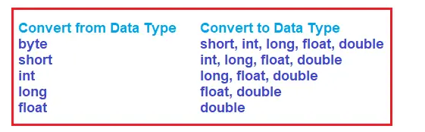
Implicit Type Casting
This is automatically done by the compiler and there will be no data loss. The Type casting is done from a smaller data type to a larger data type.
This Conversion happens when :
The two data types are compatible
When we assign a value of a smaller data type to a bigger data type.
The following is a diagram to illustrate possible conversions

Slide 21
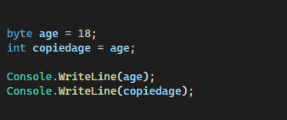

Example of implicit Type Casting

Slide 22


Explicit Type Conversion
If you want to convert the large data type to a smaller data type in C# , then you need to use explicit casting.
Here we convert large data types (like double, long) to smaller data types like (int, byte, short, float).
There is a chance of data loss or failed conversion for some reasons , so this is unsafe type of conversion.
But where is 232 coming from ? (1000- (256 *3))

Slide 23


Conversion between non-compatible types
For conversion with non- compatible types we use helper methods in C#.
Its impossible to convert this either implicitly or explicitly so for this example dotnet provides us with a class known as Convert, Parse Method and TryParse.

Slide 24
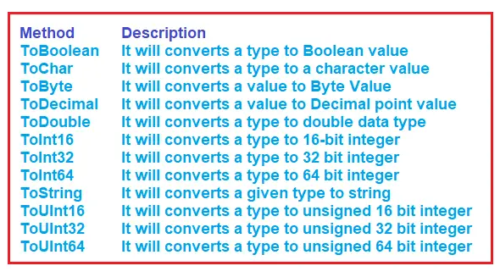
Convert Class Helper Methods In C#
The Convert class has a static methods which can be used to convert to a desired type. If the conversion is not possible I throws an error.
Here are the Methods :

Slide 25
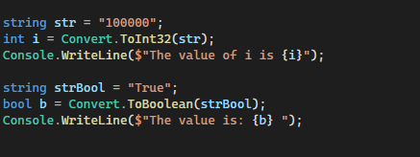

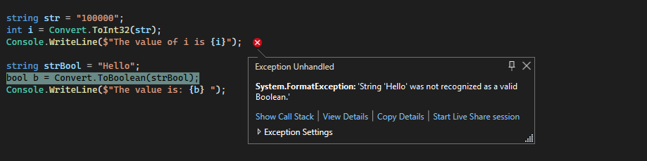
Example with Convert Class

Slide 26
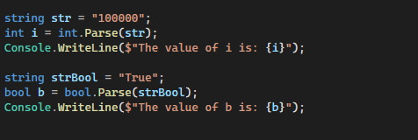

Parse() Method
In C#, we can also use the built-in Parse() method to perform type conversion. So, while performing type conversion between non-compatible types like int and string, we can also use Parse() method like the Convert class helper methods. Now, if you go to the definition of built-in value data types such as int, short, long, bool, etc., then you will see that the Parse method is implemented as a static method in those built-in value data types

Slide 27
TryParse Method
When we use the Parse method, if the conversion is not possible then at runtime, we will get an exception which is not a good thing. Because if conversion is not possible then we should show some information to the user and we should proceed further. To do so, the built-in value type class in C# is provided with the TryParse method
When we use the Parse method, if the conversion is not possible then at runtime, we will get an exception which is not a good thing. Because if conversion is not possible then we should show some information to the user and we should proceed further. To do so, the built-in value type class in C# is provided with the TryParse method. Let us see how to use the TryParse method in C#. Suppose, we want to convert a string to an integer type, then we can use the TryParse method as follows.

Slide 28
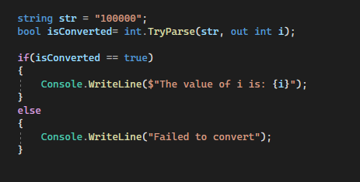

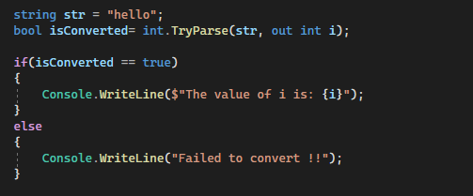

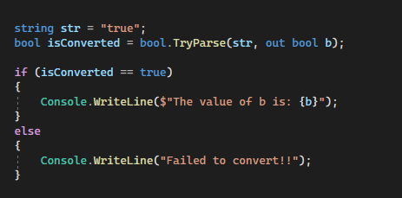


Slide 29
REFERENCE TYPES

Slide 30
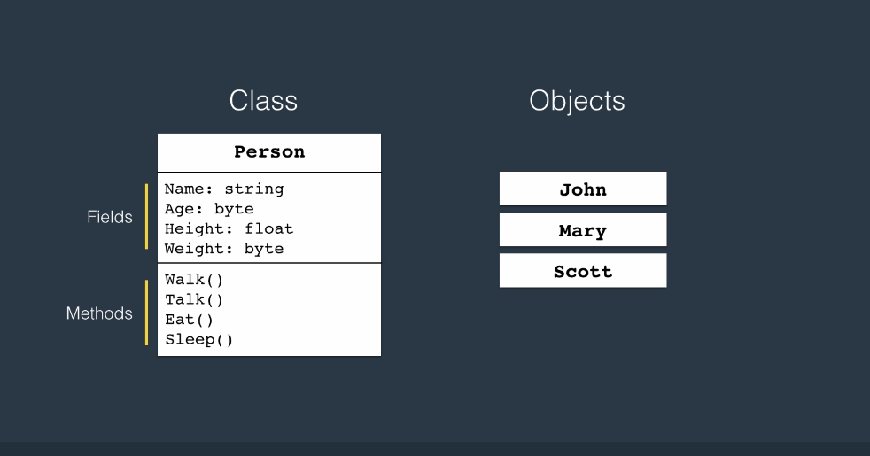
Classes
Classes combine related variables (fields) and functions (methods) together.
Classes are blueprints of objects.
To create a class we start by an access modifier , the keyword class and the name of the class .

Slide 31
Arrays
An array is a data structure to store a collection of variables of the same type.
Array has a fixed size that cant be changed after declaration.
An array is an Object.

Slide 32
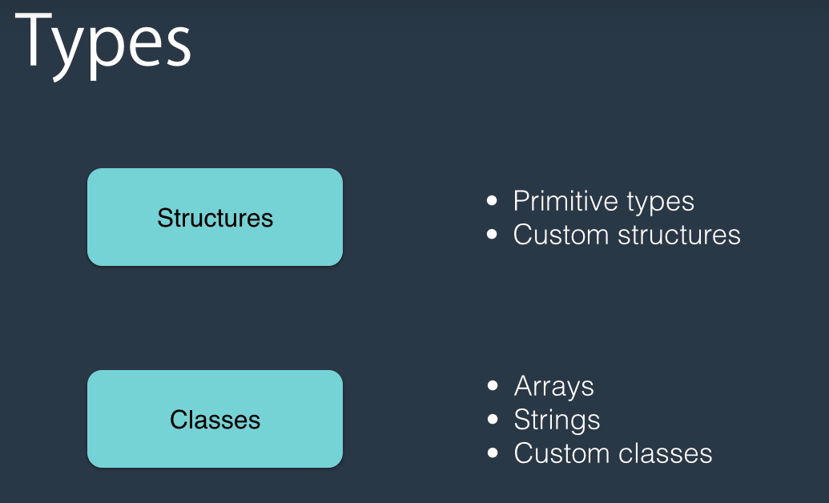
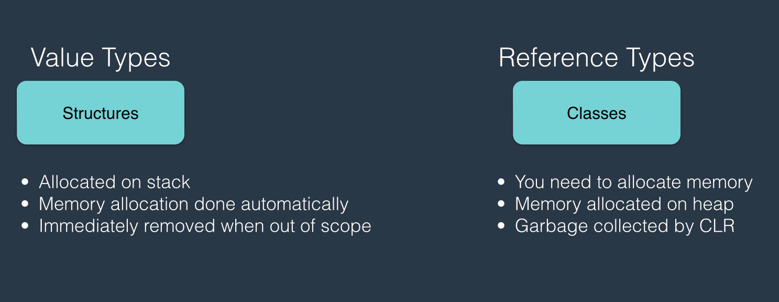
Reference Vs Value Types

Slide 33

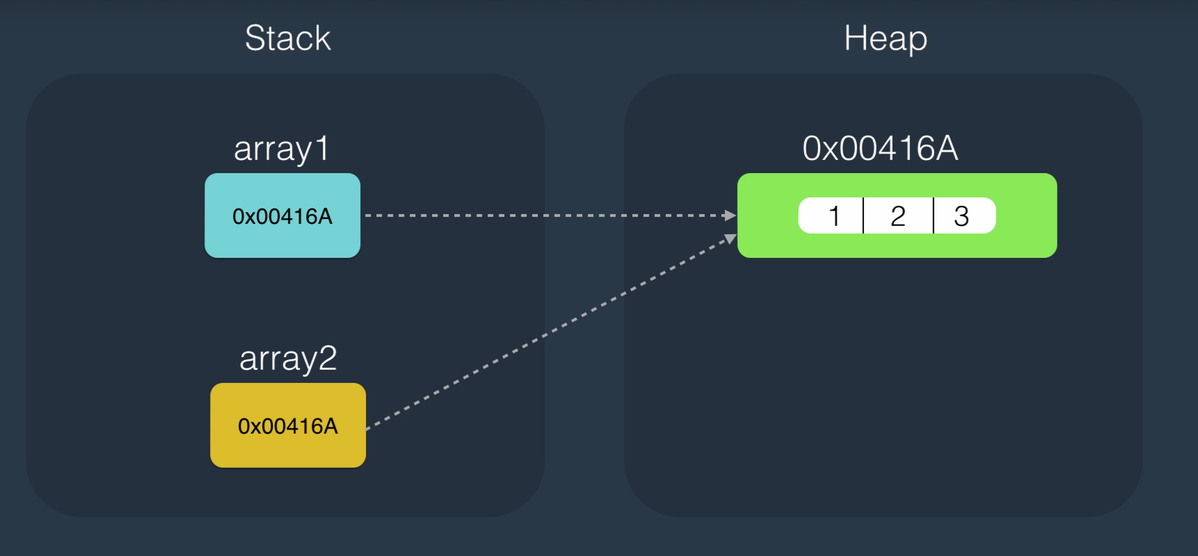
Reference Types

Slide 34
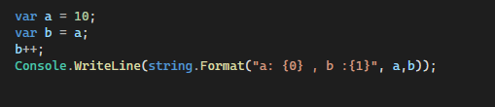
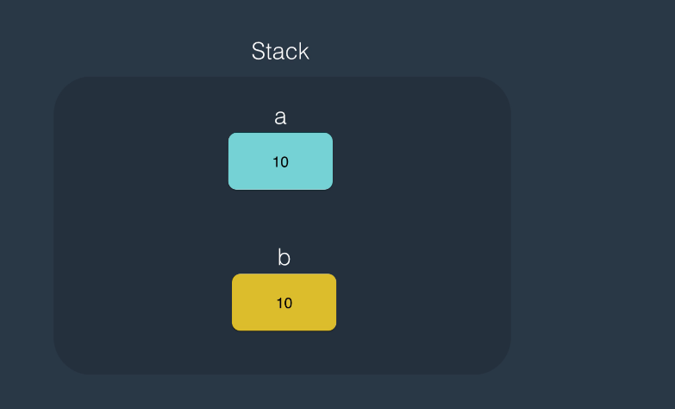
Value Types

Slide 35
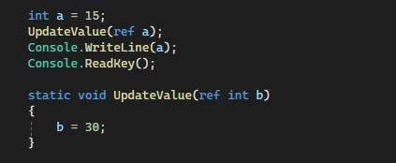
Using Ref keyword

